Slide 1
Development of Sanskrit Wordnet
Principle Investigatior
Prof. Pushpak Bhattacharya
Co-Investigator
Prof. Malhar Kulkarni

Slide 2
Lexicographers and Engineers
Dr.Irawati Kulkarni
Dr.Chaitali Dangarikar (upto June, 2010 )
Tejaswini Kinjavdekar (from April, 2011)
Tanuja Ajotikar
Abhishek Nanda
Salil Joshi
Shaukat Shahi

Slide 3
Why Sanskrit Wordnet?
  as one of the oldest Indo-European language can provide basis for the linguistic analysis of modern Indo-European languages.
  as a heritage language needs to preserve the rich lexicon of this language.
  To preserve the traditional culture and knowledge translation of Sanskrit texts is needed
  Sanskrit Wordnet can be of great help in developing Machine aided translations (MAT) system for Sanksrit.
  Text Search facility can be developed using the wordlist of Sanskrit Wordnet.
  Sanskrit has a rich lexical tradition but there is no single reference containing all these lexicas.

Slide 4
What is it good for?
  While linking WordNets into the “Indo-WordNet”- a massive semantic structure of Indian language WordNets.
  While linking the Indo WordNet to English and Euro-WordNets.

Slide 5
Universal
Category
ADJECTIVE
ADVERB
NOUN
VERB
Total
Count(1)
1789
120
4169
615
6693

Slide 6
Pan Indian
Category
ADJECTIVE
ADVERB
NOUN
VERB
Total
Count
104
18
300
17
439

Slide 7
Total Number
Category
ADJECTIVE
ADVERB
NOUN
VERB
Total
count(1)
2306
170
7033
735
10244

Slide 8
Total Number
Synsets created 10244 synsets till 31st July 2011.
Synsets evaluated and linked with HWN – 9500
Unique word count - 28930
Ratio Per Synset - 3.5
Number of entries with Etymology field 100

Slide 9
Productivity per day
Duration | Team members | Synsets per day
Nov-Dec 2008 | 1 | 10
Jan 2009 to May 2010 | 2 | 30
Jun2010 to Mar2011 | 1 | 20
April 2011 to Aug 2011 | 2 | 35

Slide 10
Range of number of synset members
Normal range of number of words in any synset is 1-20
वृद्धः (20), लीला (20), भक्षणम् (20)
Number of entries with Etymology field 100
One word synset are common in the cases of-
Coined words , Words for instruments, relations, proper nouns.
Synsets having high number of words
Names of Gods – विष्णुः (127), सोमः(120), युद्ध (99), सूर्यः (85), समुद्र (70), द्युतिमत् ADJ (92)
One word synset are common in the cases of-
Coined words , Words for instruments, relations, proper nouns.

Slide 11
Core concepts
The core concepts necessary for day-to-day communication were selected as per the suggestion by Dr. Malhar Kulkarni from Bhaaratiya vyavahaara kosha compiled by D.N. Naravane. It is a multilingual dictionary which has lexical terms in 16 Indian languages for a concept. Nearly 2000 concepts were selected as core synsets from this kosha.

Slide 12
Synset creation in the first phase
Initial word list based approach-
List of total words in the Hindi wordnet
105157
Listmmm 1-|Most frequent words of Sanskrit| 8338
Problems faced:
List 2-| Unique words of the Sanskrit epics| 127796
Domain based approach (which later extended to all Indian language wordnets): Based on Naravane’s भारतीय व्यवहार कोश most common words of Indian languages from following domains are selected.
Part of Speech distribution: 1512 Nouns, 225 Verbs, 180 Adjectives and 52 adverbs
1) Grains and Cereals | 2) Limbs of Humans | 3) Medical treatment | 4) Tools & implements | 5) Worms & Insects
6) Minerals | 7) Food and Drinks | 8)Games & sports | 9) Ornaments & Trinkets | 10) Household articles
11) Limbs of animals | 12) Post office | 13) Vegetables | 14) Directions | 15) Country
16) Religion | 17) Court | 18) Birds | 19) Trees & plants | 20) Dress
21) Nature | 22) Animals | 23) Fruits | 24) Flowers | 25) Young-ones of animals
26) Amusement | 27) Spices | 28) Weights & measures | 29) Colours | 30) Relatives
31) Diseases | 32) Reptiles | 33) Conveyances | 34) Occupations | 35) Education
36) Time | 37) Government | 38) Verbs | 39) Adverbs | 40) Abstract nouns
41) Adjectives | 42) Prepositions | 43) Numerals | 44) Conjunctions | 45) Collective words
46) Pronouns | 47) Ordinals | 48) Feminines | 49) Interjections | 50) War
51) House | 52) Miscellaneous

Slide 13
Categorization
Synset categorization is an act of distributing synsets into categories of different kinds.
These categories are Core, Common, Common in Indian language, Common in Hindi and Uncommon.
This categorization was done at IIT Bombay in March 2009 before the first IndoWordnet workshop was organized in Coimbatore from 11th to 14th June 2009.

Slide 14
Continuation
The exercise of categorization was repeated to resolve the problems occurred with earlier categorization: New categorization was done in May 2010 and this time synsets were categorized into 6 categories instead of the initial 4 by different Wordnet groups.
Universal: Synsets which have an indigenous lexeme in all the languages (e.g. Sun ,Earth).
Pan Indian: Synsets which have indigenous lexeme in all the Indian languages but no English equivalent (e.g. Paapad).
In-Family: Synsets which have indigenous lexeme in the particular language family (e.g. Bhatija in Dravidian languages).
Language specific: Synsets which are unique to a language (e.g. Bihu in Assamese language)
Rare: Synsets which express technical terms (e.g. ngram).
Synthesized: Synsets created in the language due to influence of another language (e.g. Pizza).

Slide 15
Inserting Concepts or glosses in the Sanskrit Wordnet
A combination of the glosses given in dictionaries like शब्दकल्पद्रुम and the translation of the gloss of the Hindi wordnet synset is used to create the Sanskrit synset glosses.
While writing the gloss, complicated सन्धि and समास (compounds) are avoided.
Whenever lengthy compounds (having 5-6 members) became necessary, the members of the compounds were invariably joined with the hyphen symbol (-) as in: “अन्य-स्थान-संयोगानुकूल-व्यापार meaning the activity that is helpful in reaching a place”
the gloss of a verb in Sanskrit is generally created using technical terms like व्यापार ‘action’, जन्य ‘produced,’ अनुकूल ‘helpful,’ etc

Slide 16
Some Language Specific Problems
Problem 1- Concepts of पंचमहाभूतs
Example - like जल
Available Hindi Synsets
1.water (ID 1930) it is natural water(जलम्, वारि, अम्बु, अम्भः, पयः, सलिलम्, सरिलम्, उदकम्, उदम्, जडम्, पयस्, तोयम्, पानीयम्, आपः, नीरम्, वाः, पाथस्, कीलालम्, अन्नम्, अपः, पुष्करम्, अर्णः, पेयम्, सलम्, संवरम्, शंवरम्, संम्बम्, संवत्सरम्, संववरः, क्षीरम्, पायम्, क्षरम्, कमलम्, कोमलम्, पीवा, अमृतम्, जीवनम्, जीवनीयम्, भुवनम्, वनम्, कबन्धम्, कपन्धम्, नारम्, अभ्रपुष्पम्, घृतम्, कं, पीप्पलम्, कुशम्, विषम्, काण्डम्, सवरम्, सरम्, कृपीटम्, चन्द्रोरसम्, सदनम्, कर्वुरम्, व्योम, सम्बः, सरः, इरा, वाजम्, तामरस, कम्बलम्, स्यन्दनम्, सम्बलम्, जलपीथम्, ऋतम्, ऊर्जम्, कोमलम्, सोमम्, अन्धम्, सर्वतोमुखम्, मेघपुष्पम्, घनरसः, वह्निमारकः, दहनारातिः, नीचगम्, कुलीनसम्, कृत्स्नम्, कृपीटम्, पावनम्, शरलकम्, तृषाहम्, क्षोदः, क्षद्मः, नभः, मधुः, पुरीषम्, अक्षरम्, अक्षितम्, अम्ब, अरविन्दानि, सर्णीकम्, सर्पिः, अहिः, सहः, सुक्षेम, सुखम्, सुरा, आयुधानि, आवयाः, इन्दुः, ईम्, ऋतस्ययोनिः, ओजः, कशः, कोमलम्, कोमलम्, क्षत्रम्, क्षपः, गभीरम्, गम्भनम्, गहनम्, जन्म, जलाषम्, जामि, तुग्र्या, तूयम्, तृप्तिः, तेजः, सद्म, स्रोतः, स्वः, स्वधा, स्वर्गाः, स्वृतिकम्, हविः, हेम, धरुणम्, ध्वस्मन्वतु, नाम, पवित्रम्, पाथः, अक्षरम्, पूर्णम्, सतीनम्, सत्, सत्यम्, शवः, शुक्रम्, शुभम्, शम्बरम्, वूसम्, वृवूकम्, व्योमः, भविष्यत्, वपुः, वर्वुरम्, वर्हिः, भूतम्, भेषजम्, महः, महत्, महः, महत्, यशः, यहः, यादुः, योनिः, रयिः, रसः, रहसः, रेतम्
Concept - सिन्धुहिमवर्षादिषु प्राप्तः द्रवरुपो पदार्थः यः पान-खान-सेचनाद्यर्थम् उपयुज्यते।
Example-"अजीर्णे जलम् औषधं जीर्णे बलप्रदम्। आहारकाले आयुर्जनकं भुक्तान्नोपरि रात्रौ न पेयम्॥").

Slide 17
Required number of synsets in SWN
अप् as महाभूत in Sanskrit it is an element which we find in each body will not be covered under this concept
H2O the chemical product of hydrogen and oxygen is not covered.
To solve it, we will create two different synsets for these two different sense.

Slide 18
Problem 2- Astronomical entity and deity
Sun (ID2186)सूर्यः, सविता, आदित्यः, मित्रः, अरुणः, भानुः, पूषा, अर्कः, हिरण्यगर्भः, पतङ्गः, खगः, सहस्रांशुः, दिनमणिः, मरीचि, मार्तण्ड, दिवाकरः, भास्करः, प्रभाकरः, विभाकरः, विवस्वान्, सप्ताश्वः, हरिदश्वः, चित्ररथः, सप्तसप्तिः, दिनमणि, द्युमणिः, दिवामणिः, खमणिः, खद्योतः, प्रद्योतनः, म्बरीशः, अंशहस्तः, लोकबान्धवः, जगत्चक्षुः, लोकलोचनः, कालकृतः, कर्मसाक्षी, गोपतिः, गभस्तिः, गभस्तिमान्, गभस्तिहस्तः, ग्रहराजः, चण्डांशु, अंशुमानी, उष्णरश्मिः, तपनः, तापनः, ज्योतिष्मान्, मिहिरः, अव्ययः, अर्चिः, पद्मपाणिः, पद्मिनीवल्लभः, पद्मबन्धुः, पद्मिनीकान्तः, पद्मपाणिः, हिरण्यरेतः, काश्यपेयः, विरोचनः, विभावसुः, तमोनुदः, तमोपहः, चित्रभानुः, हरिः, हरिवाहनः, ग्रहपतिः, त्विषाम्पतिः, अहःपतिः, वृध्नः, भगः, अगः, अद्रिः, हेलिः, तरूणिः, शूरः, दिनप्रणीः, कुञ्जारः, प्लवगः, सूनुः, रसाधारः, प्रतिदिवा, ज्योतिपीथः, इनः, वेदोदयः, पपीः, पीतः
concept- पृथिव्याः निकटतमः अतितेजस्वी खगोलीयः पिण्डः यं परितः पृथ्व्यादिग्रहाः भ्रमन्ति। तथा च यः आकाशे सुवति लोकम् कर्माणि प्रेरयति च।
example- "सूर्यः सौर्याः ऊर्जायाः महीयः स्रोतः। सूर्ये तपत्यावरणाय दृष्टैः कल्पेत लोकस्य कथं तमित्स्रा"[रघु 5.13]"

Slide 19
Sun as god
Sun(ID26471)सूर्यः, सूरः, अर्यमा, आदित्यः, द्वादशात्मा, दिवाकरः, भास्करः, अहस्करः, व्रध्रः, प्रभाकरः, विभाकरः, भास्वान्, विवस्वान्, सप्ताश्वः, हरिदश्वः, उष्णरश्मिः, विवर्त्तनः, अर्कः, मार्त्तण्डः, मिहिरः, अरुणः, वृषा, द्युमणिः, तरणिः, मित्रः, चित्रभानुः, विरोचन्, विभावसुः, ग्रहपतिः, त्विषाम्पतिः, अहःपतिः, भानुः, हंसः, सहस्त्रांशुः, तपनः, सविता, रविः, शूरः, भगः, वृध्नः, पद्मिनीवल्लभः, हरिः, दिनमणिः, चण्डांशुः, सप्तसप्तिः, अंशुमाली, काश्यपेयः, खगः, भानुमान्, लोकलोचनः, पद्मबन्धुः, ज्योतिष्मान्, अव्यथः, तापनः, चित्ररथः, खमणिः, दिवामणिः, गभस्तिहस्तः, हेलिः, पतंगः, अर्च्चिः, दिनप्रणीः, वेदोदयः, कालकृतः, ग्रहराजः, तमोनुदः, रसाधारः, प्रतिदिवा, ज्योतिःपीथः, इनः, कर्म्मसाक्षी, जगच्चक्षुः, त्रयीतपः, प्रद्योतनः, खद्योतः, लोकबान्धवः, पद्मिनीकान्तः, अंशुहस्तः, पद्मपाणिः, हिरण्यरेताः, पीतः, अद्रिः, अगः, हरिवाहनः, अम्बरीषः, धामनिधिः, हिमारातिः, गोपतिः, कुञ्जारः, प्लवगः, सूनुः, तमोपहः, गभस्तिः, सवित्रः, पूषा, विश्वपा, दिवसकरः, दिनकृत्, दिनपतिः, द्युपतिः, दिवामणिः, नभोमणिः, खमणिः, वियन्मणिः, तिमिररिपुः, ध्वान्तारातिः, तमोनुदः, तमोपहः, भाकोषः, तेजःपुञ्जः, भानेमिः, खखोल्कः, खद्योतनः, विरोचनः, नभश्चक्षूः, लोकचक्षूः, जगत्साक्षी, ग्रहराजः, तपताम्पतिः, सहस्त्रकिरणः, किरणमाली, मरीचिमाली, अंशुधरः, किरणः, अंशुभर्त्ता, अंशुवाणः, चण्डकिरणः, धर्मांशुः, तीक्ष्णांशुः, खरांशुः, चण्डरश्मिः, चण्डमरीचिः, चण्डदीधितिः, अशीतमरीचिः, अशीतकरः, शुभरश्मिः, प्रतिभावान्, विभावान्, विभावसुः, पचतः, पचेलिमः, शुष्णः, गगनाध्वगः, गगणध्वजः, खचरः, गगनविहारी, पद्मगर्भः, पद्मासनः, सदागतिः, हरिदश्वः, मणिमान्, जीवितेशः, मुरोत्तमः, काश्यपी, मृताण्डः, द्वादशात्मकः.
Concept - हिन्दूधर्मग्रंथेषु वर्णिता एका देवता।
Example- "वेदेषु सूर्यदेवस्य पूजायाः विधानम् अस्ति"।

Slide 20
Sun Astronomical Entity
Sun(ID27078)सूर्यः
concept- सः ज्योतिष्मान् खपिण्डः यस्य परितः ग्रहाः परिभ्रमन्ति।
example- "अन्तरिक्षे नैके सूर्याः सन्ति।"

Slide 21
Continuation
Three different kind of synsets for word Sun.
All three has different meanings.
For example-
1 Astronomical object which is the part of the solar system of the earth.
2 God.
3 Astronomical object related to any other solar system.

Slide 22
Continuation
The first synset we have not used the names of sun which denotes sun as a god.
The second synset we have tried to incorporate all the words which denote sun as a god.
The third one there is only word सूर्यः because it is an astronomical object for other solar system.

Slide 23
Verbs
Gloss of Verbs in SWN- takes care of the syntactic relations along with the semantics
गमन = एकस्थानवियोगपूर्वकः पादविक्षेपयुक्तः अन्यस्थानसंयोगानुकूलः व्यापारः।
अपादान
कर्ता
कर्म
Unique Task
Needs training in the traditional grammar and Nyāya
school

Slide 24
The problems faced during the task of framing the gloss of verbs in SWN
Lack of lexical resources-
The creation of glosses following the Navya-Nyāya terminology is a very unique task.
There is no account available of such ‘semantico-syntactic’ definition of each and every verb in Sanskrit.
The traditional texts of grammar, न्याय, मीमांसा etc. use such expressions in the discussions.
These kinds of examples are very few and repeated. So it is obvious that it is a challenge for a lexicographer to form such a definition.

Slide 25
Stative and Abstract Verbs-
The stative verbs and the verb denoting abstract concepts are difficult to deal with; e.g. ज्ञा (to know), इच्छ् (to desire), भू (to be), अस् (to be), नश् (to destroy) etc.
It is very puzzling to decide what kind of व्यापार it has.
We refer to here वैयाकरणभूषणसार specially.
It says that in the sentences like घटो नश्यति (the pot destroys) the presence of a stick etc. are said to be व्यापार of नश् (to destroy). It phrases this व्यापार as प्रतियोगित्वविशिष्टनाशसामग्रीसमवधानम्। (the presence of a stick etc.which cause the destruction). We have avoided complicated definitions and give definitions like ध्वंसानुकूलः व्यापारः। of नश् (to destroy).
The same strategy is adopted in phrasing the definition of the roots like ज्ञा (to know), इष् (to desire) etc.

Slide 26
Adverb
Technically adverbs in Sanskrit do not get conjugated as nouns and adjectives.
Some adverbs in Sanskrit are freezed forms. They are found with case endings eg; उच्चैः, नीचैः, मुहुः etc. so surface level forms are stored not the root words.
Even some verbal forms act as an adverb; they are too stored in an accomplished form, not in root words.
Some compounds like अव्ययीभाव also act as an adverb eg. सत्वरम्.
The suffixes like तस्, शस् etc. when added to a nominal base then it acts as an adverb eg. प्रसन्नतः|

Slide 27
Problems faced by SWN lexicographers.
Most of the concepts expressed by adverbs are seen related to the aspect of an action, temporal and spatial substratum.
Problem of PoS: Adverb or Indeclinable?
  अव्ययs in Paninian grammar are “underived nominal stems” (अव्युत्पन्न-प्रातिपदिक).
  They convey mere प्रातिपदिकार्थ (meaning of the stem).
  Panini considers them as nominative words.
    चिरम् (acc. sing), चिरेण (instru. sing), चिरात् (abl. sing)
  According to Panini, each अव्यय is a separate lexical item.
    Adjective चिर →Adverb {चिरम्, चिरेण, चिरात्} (derived from link is not acceptable in Paninian system)

Slide 28
PoS in the SWN
Since Sanskrit Wordnet (SWN) is built in expansion approach, we have two options:
  Retain the PoS in the expansion approach or
  Create different PoS for Sanskrit and allow cross PoS linkage in SWN.

Slide 29
Problem of lexicalization
Adverb "there":
  Concept: तस्मिन् स्थाने।
  Example: भवतः पुस्तकं तत्र वर्तते।
  Synset: तत्र, तत्स्थाने, तद्देशे, तत्स्थले, तस्मिन् स्थाने, तस्मिन् देशे, तस्मिन् स्थले.
Here only “तत्र” is अव्यय.
All other synset members are not अव्ययs.
These multiword expressions express the same sense which the अव्यय “तत्र” expresses.

Slide 30
Problem of non-lexicalized words
Some times Sanskrit words are not available for the given concept in the Hindi wordnet for example पूरी, पाना etc.
In such places if we have the similar concept in the Sanskrit we have extended it. Here we have extended the concept of अपूप for पूरी.

Slide 31
Continuation
For cases such as पाना invented in modern times the words are not readily available.
In such a cases the words are taken from Dictionaries for technical terminology prepared by Maharashtra Govt. or Indian Govt.
The other option is to rely on spoken Sanskrit Dictionary which includes newly coined words by Sanskrit speaking people.

Slide 32
continuation
And if we don’t find it in this dictionary then we search for a verb which describes the concept and use a suffix in the sense of करण as पाना is instrument.
For example- परिमा means “to span to” and तीव्राकुञ्चनं कृत्वा आकर्ष् means “to wrench”. So in this way we can describe the concept of पाना in Sanskrit using these two verbs like तद् उपकरणं येन कीलः परिमाय तीव्राकुञ्चनेन आकृष्यते। and as the action of wrenching is more prominent, we can form a word आकर्षः for Hindi concept of पाना.

Slide 33
Modern terms
There are modern developments, like modern games which are obviously not captured by Sanskrit vocabulary, like, “चौपड़”, “ताश”, “बादशहा (in the game of cards)”, “बेगम (in the game of cards)” etc.

Slide 34
Continuation
In case of चौपड़, we have find follwing description in HWN- चौपड़,चौसर,पासा,पाँसा,आकर्ष एक खेल जो बिसात पर गोटियों से खेला जाता है.This concept is very close to the concept of द्यूत. So we can explain it using this idea like- पणपूर्विका क्रीडा यत्र जयपराजयार्थे जनाः पटे अक्षान् दीव्यन्ति। and can use words (द्यूतः, अक्षः, पाशः). Similarly we can use “राजा” for बादशहा (in the game of cards), “राज्ञी” for बेगम (in the game of cards).

Slide 35
तत्सम word
The meaning of the तत्सम word gets contracted in Hindi. Thus the word “वशीकृत” which means in Sanskrit, “to have control over something which was not under control” gets limited scope in Hindi and a negative one at that. It is recorded to mean “to control someone with the help of मन्त्र and तन्त्र”.

Slide 36
Connotation in Hindi
There are some concepts available in Sanskrit which have got an entirely different connotation in Hindi. Thus the concept, “स्त्रीधन” in Sanskrit which connotes the sense, namely, “the wealth of/for a woman” gets diverted in Hindi through the concept of “दहेज” which connotes to the sense namely, “something given by the bride’s parents to the groom”[to make up for deficiency-Dictionary]

Slide 37
Achievements
Wordnet for Sanskrit language is being created at IIT Bombay using expansion approach. Hindi Wordnet is used as pivot language for this purpose.
Sanskrit Wordnet is available online at:
http://www.cfilt.iitb.ac.in/wordnet/webswn
Similar to Hindi Wordnet, the Sanskrit Wordnet is created using PHP for front-end and MySQL database for back-end.
The Wordnet is created using a file based tool, and the data created using this tool is regularly updated in the database for public availability.

Slide 38
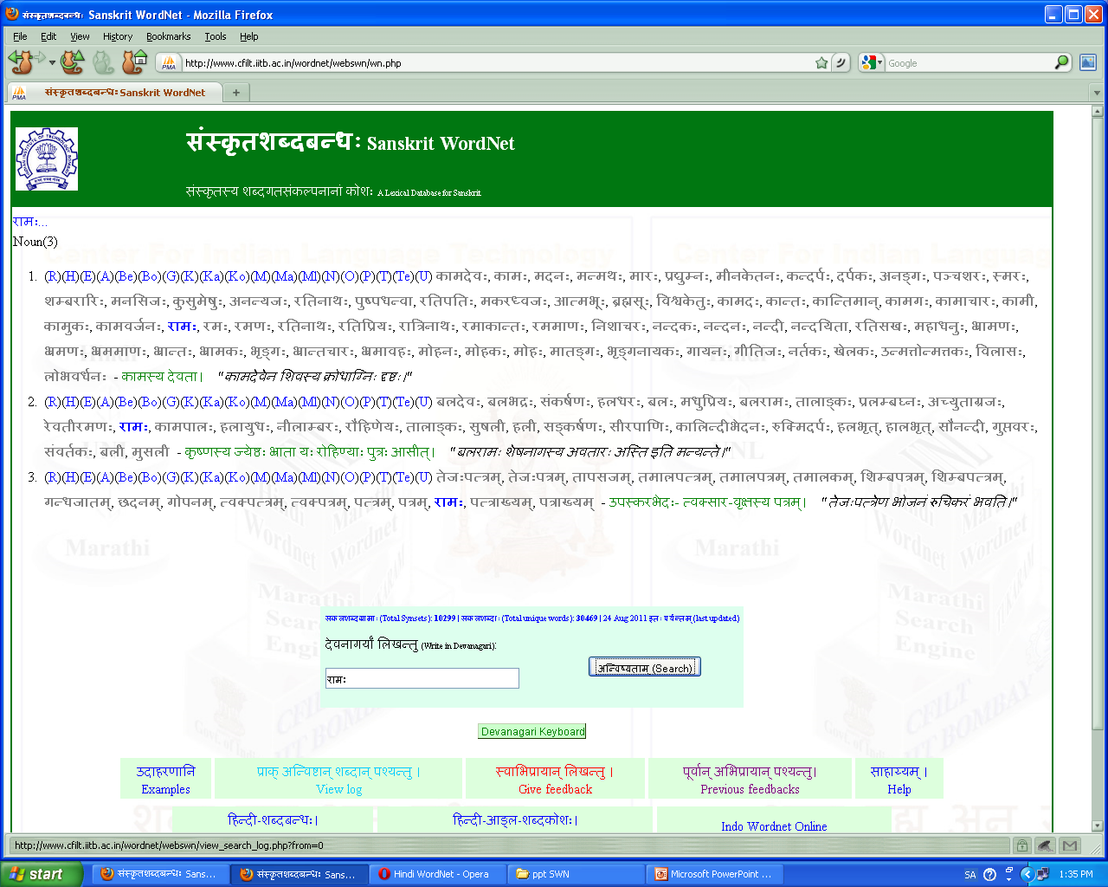
Interface

Slide 39
SWN and Indo-Wordnet
Part of Indo-Wordnet activity
Available on Indo-Wordnet url
Linked to 10+Languages
Useful for disambiguiation of Tatsama words.
Useful resource

Slide 40
Observations on SWN
Expansion approach provides for insights.
Lexical X Grammatical
POS identification- Avyaya
Journey of polysemous words in Sanskrit to Hindi and other Indic languages
Loss of Polysemy
Increase of Polysemy

Slide 41
Future work
Use of ontology of नव्य-न्याय (Navya-NyAya)
The traditional Sanskrit Texts on Philosophy as well as Medicine contain various discussions on ontological categories and hierarchies.
These texts are closely related to the grammar of the Sanskrit Language.
The comparison of these ontological structures and hierarchies to the existing one coming from the Hindi wordnet may shed light on new Indowordnet specific issues.

Slide 42
धातु based WN
There are theories in Sanksrit texts which adhere to the view that all nouns are derived from verbal roots.
There is a need to test this theory and build a lexical structure where all the verbal roots will be at the nodal level with connected nouns at the leaf level.
A brief introduction of this is available in (Vrbal roots in the Sanskrit Wordnet Kulkarni and Bhattacharyya, 2009).

Slide 43
semantic relations
Hindi Wordnet captures semantic relations (e.g. Hypernymy, Hyponymy etc.) for the synsets.
Since Sanskrit Wordnet follows expansion approach, it inherits all these relations automatically. As of now, these relations are not stored in Sanskrit Wordnet database, and hence not shown online.
In near future, the relations will be copied from Hindi Wordnet, and shown on Sanskrit Wordnet online interface.

Slide 44
Financial and Technical Details

Slide 45
Financial Details upto 31.7.2011
Expense Head | Amount Received | Amount Spent | Remaining Projected Amount to be received from CIIL for this year
Pay & Allownces | 350000 | 139580 | 650000
TADA | 100000 | ----------- | 100000
Contingency | 76087 | 24700 | 223013
Overheads | 78913 | 78913 | 221087
Total | 605000 | 243193 | 1350000

Slide 46
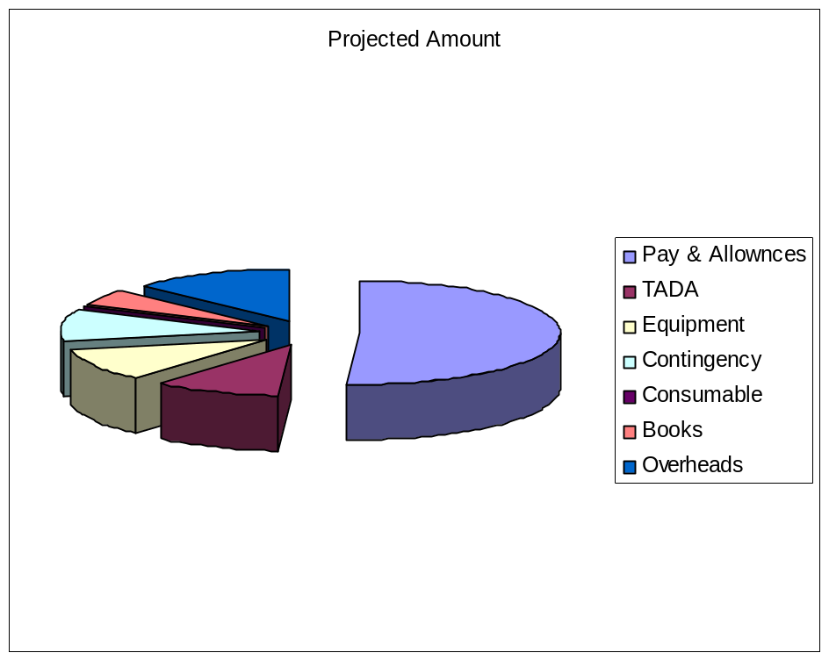
Plan for next one year
Month/Progress | 3 | 6 | 9 | 12
No. of Synset | 12000 | 14000 | 16000 | 18000
Evaluation Method | Internal | Internal | Internal | External
Manpower Required | 4 | 4 | 4 | 4

Slide 47
Publications
Kulkarni, M. and Bhattacharrya P.
2009 Verbal Roots in the Sanskrit Wordnet: Sanskrit Computational Linguistic Symposium, Lecture Notes in Computer Science, (edi.) Huet, G. and Kulkarni A., Berlin: Springer-Verlag/Heidelberg, pp. 328-338
Kulkarni, M., Kulkarni I., Dangarikar, C.and Bhattacharrya, P.
2010 Gloss in Sanskrit Wordnet, Sanskrit Computational Linguistic Symposium, Lecture Notes in Computer Science, 6465, (edi.) Jha, G. Berlin: Springer-Verlag/Heidelberg, pp. 190-198
Kulkarni, M., Kulkarni I., Dangarikar, C., Bhattacharyya P., and Nanda, A., 2010 Introducing Sanskrit Wordnet, 5th Global Wordnet Conference,2010

